Slide 1
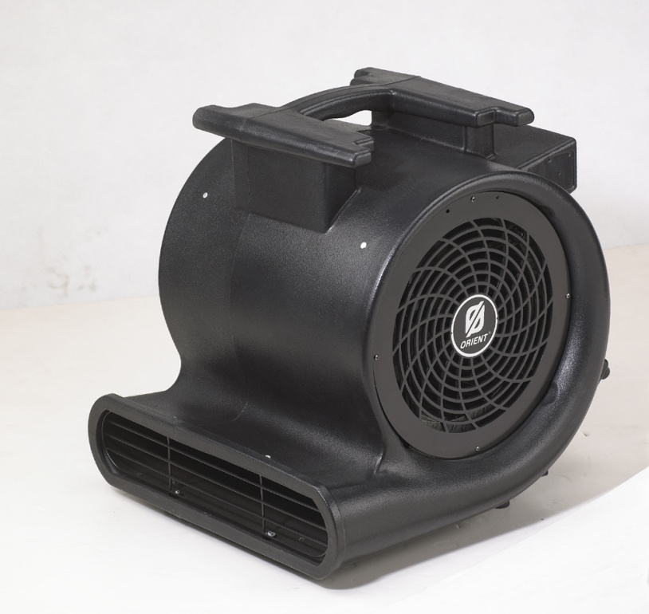
▣ Specification ▣
 | Parameter | Description | Remark
 | Product | Industrial Fan Blower
 | Model | HVB-4000
 | Supplier | ORIENT
 | Safety Approval | ETL
 | Voltage | 120 | VAC
 | Frequency | 60Hz | Hz
 | Current | 10 | A
 | Power Consumption | 1200 W | W
 | No. of speed | 3
 | Motor RPM | 1400
 | Air Volume | 4000 | CFM
 | Noise | 80 | dB
 | Product Weight | 16.0 | kg
 | Power cord length | 25 | ft
 | Product size | 46.0 x 52.0 x 47.0 | cm (W x L x H)
 | Carton size | 55.0 x 49.0 x 53.0 | cm (W x L x H)
 | Container loading quantity | 186/20’, 384/40’, 470/40’HQ, 520/45’ | pcs
 | Quantity per carton | 1 | pcs
Remark

